Slide 1
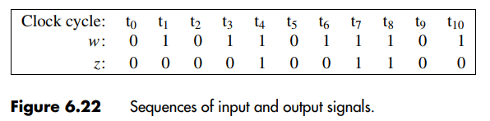



Example 2: A Simple Input Pattern (‘11’ Overlapping Sequence) Detection Circuit (Mealy Type)
Steps->
State diagram
State table
State assigned table
K-map
Circuit

Slide 2
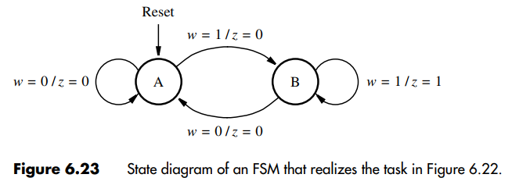
Example 2: A Simple Input Pattern (‘11’ Overlapping Sequence) Detection Circuit (Mealy Type)
Steps->
State diagram
State table
State assigned table
K-map
Circuit

Slide 3
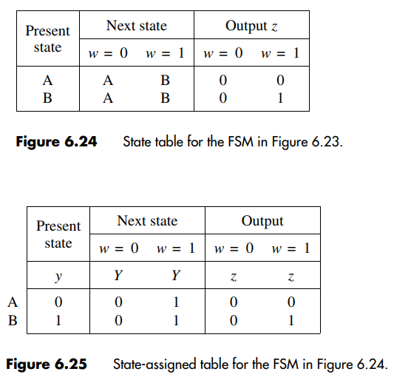
Example 2: A Simple Input Pattern (‘11’ Overlapping Sequence) Detection Circuit (Mealy Type)
Steps->
State diagram
State table
State assigned table
K-map
Circuit
Note that,
Y = f(w,y)
z = f(w,y)

Slide 4
Example 2: A Simple Input Pattern (‘11’ Overlapping Sequence) Detection Circuit (Mealy Type)
Steps->
State diagram
State table
State assigned table
K-map (Y and z)
Circuit
Y =>
w
y
0
1
0
0 | 1
0 | 1
Y = w
1
z =>
w
y
0
1
Note that,
Y = f(w,y)
z = f(w,y)
0
0 | 0
0 | 1
z = wy
1

Slide 5
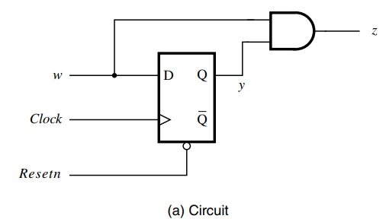
Example 2: A Simple Input Pattern (‘11’ Overlapping Sequence) Detection Circuit (Mealy Type)
Steps->
State diagram
State table
State assigned table
K-map
Circuit

Slide 6
Encoding Schemes (State Assignment)
Consider a state assigned table below:
Present state
Next state
w=0 w=1
Output
z
Schemes->
Binary encoding
Gray encoding
One-hot encoding
 | y ₂ y ₁ | Y ₂ Y ₁ | Y ₂ Y ₁
A | 00 | 00 | 01 | 0
B | 01 | 00 | 10 | 0
C | 10 | 00 | 10 | 1
 | 11 | dd | dd | d

Slide 7
Encoding Schemes (State Assignment)
Consider another state assigned table below:
Present state
Next state
w=0 w=1
Output
z
Schemes->
Binary encoding
Gray encoding
One-hot encoding
 | y ₂ y ₁ | Y ₂ Y ₁ | Y ₂ Y ₁
A | 00 | 00 | 01 | 0
B | 01 | 00 | 11 | 0
C | 11 | 00 | 11 | 1
 | 10 | dd | dd | d

Slide 8
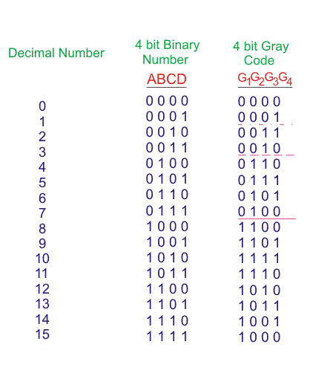

Slide 9
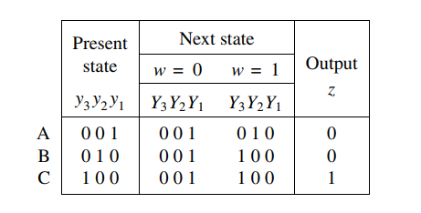
Encoding Schemes (State Assignment)
Consider another state assigned table below:
Schemes->
Binary encoding
Gray encoding
One-hot encoding
How many flipflops are required?
Ans: 3

Slide 10
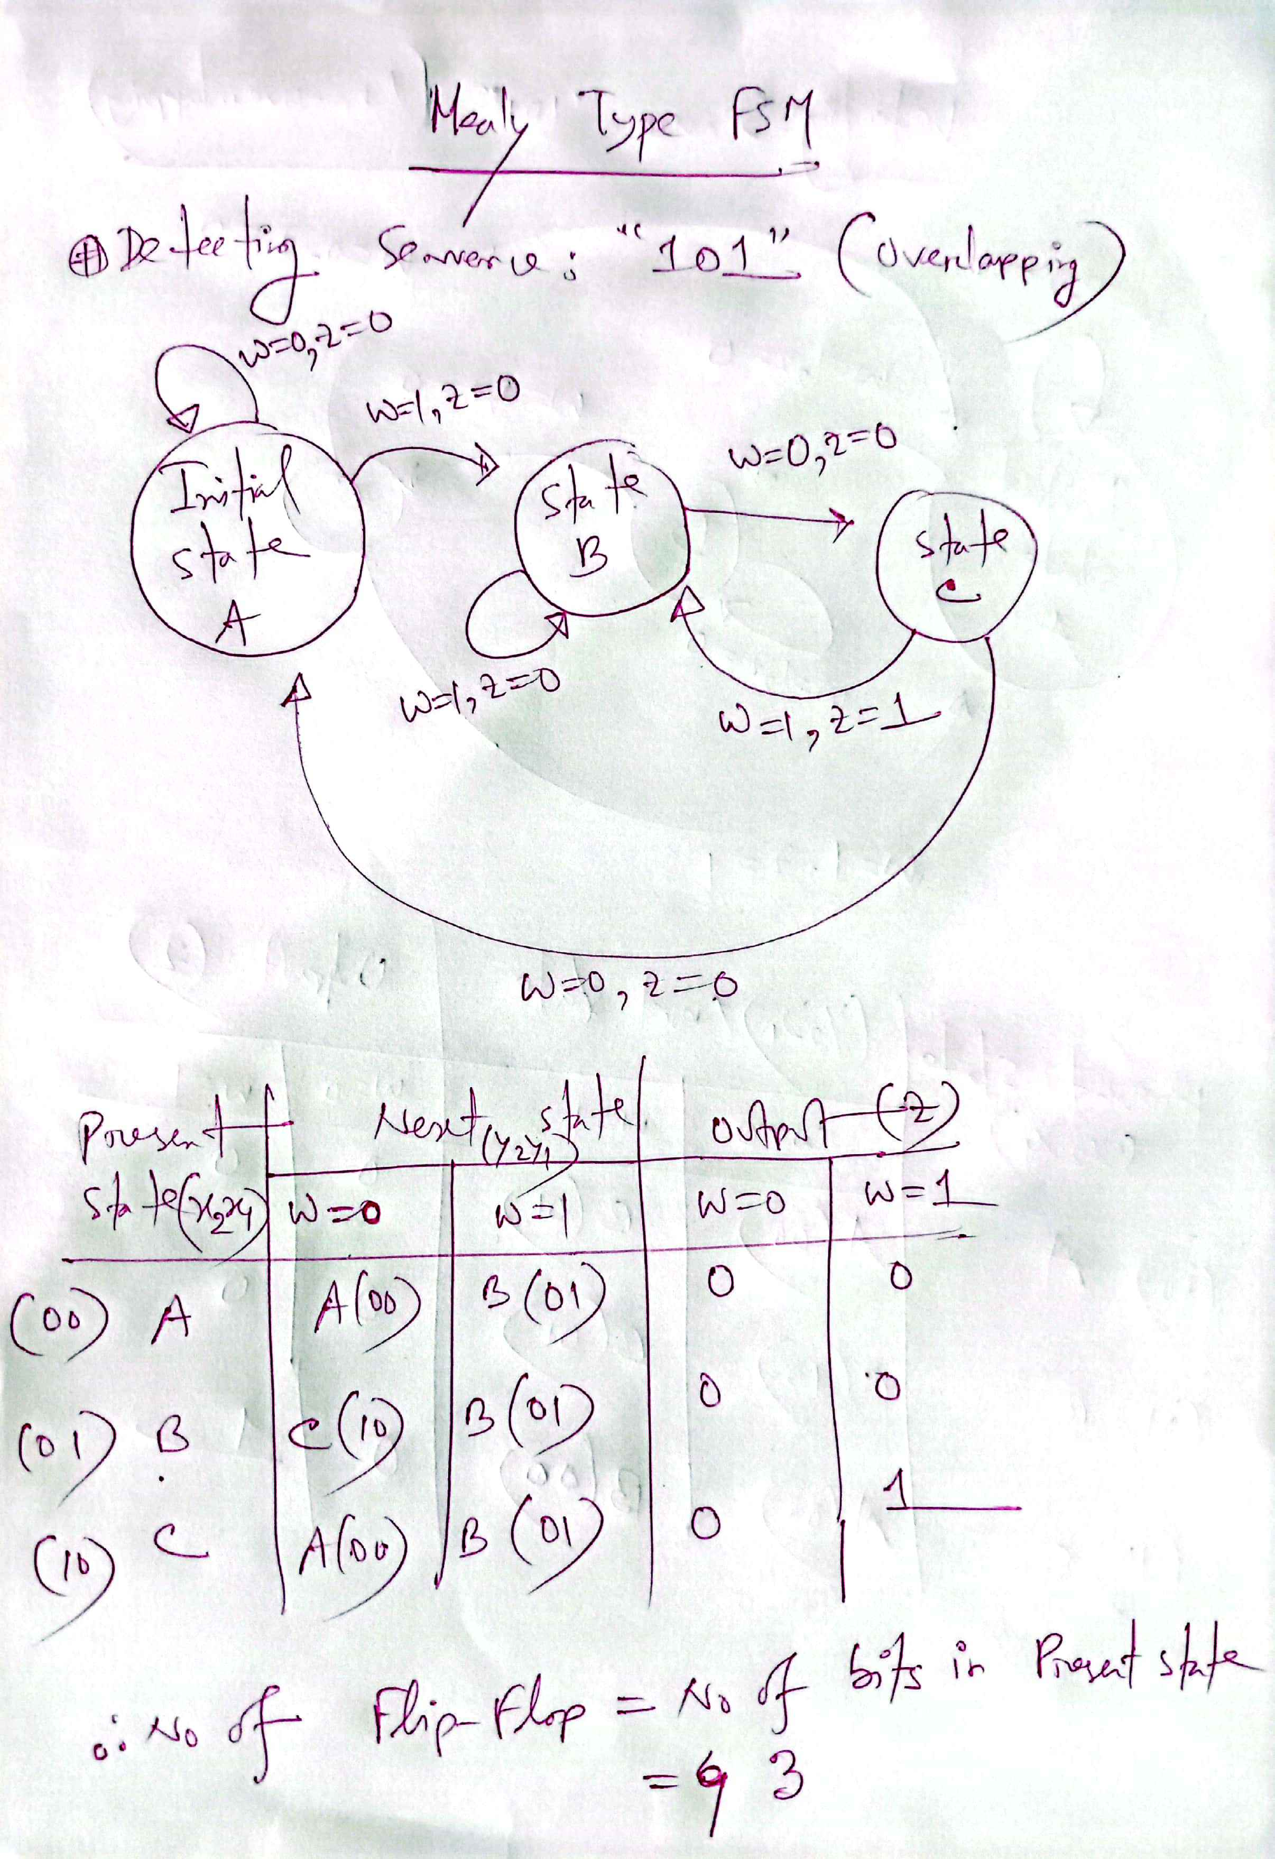
Example 2: A Simple Input Pattern (‘101’ Overlapping Sequence) Detection Circuit (Mealy Type)
Important:
In Mealy Type FSM, you do not need to declare a separate state for your final output (for this example: no separate state for ‘101’ is required). After getting your output z = 1, you will start your 2nd loop (Start finding z=1 for the 2nd time).
2

Slide 11
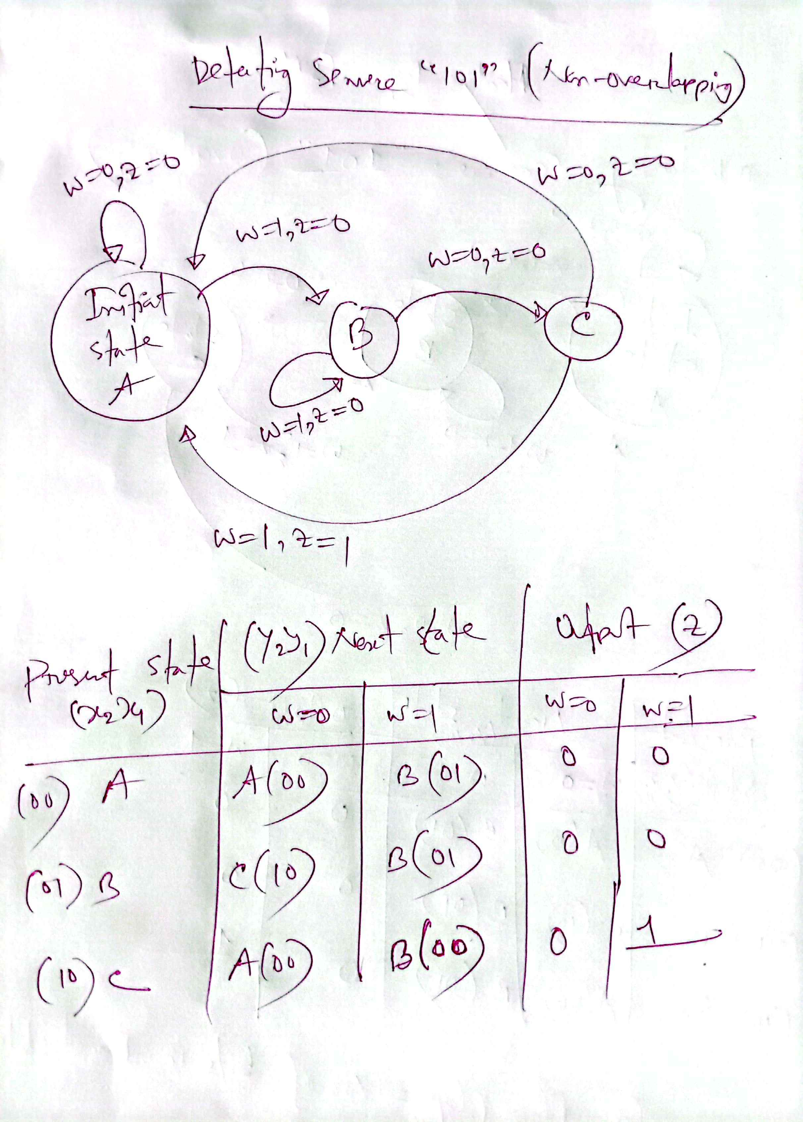
Example 2: A Simple Input Pattern (‘101’ Non-Overlapping Sequence) Detection Circuit (Mealy Type)
A (00)

Slide 12
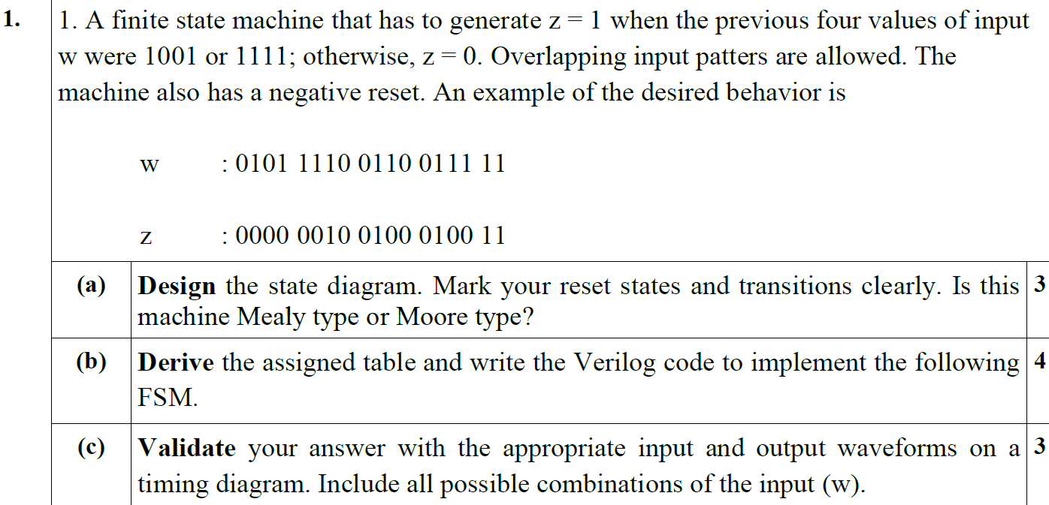
Example 3:

Slide 13
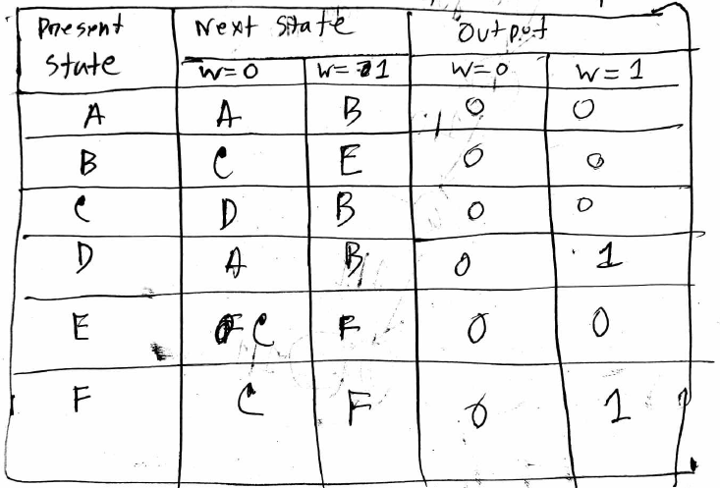
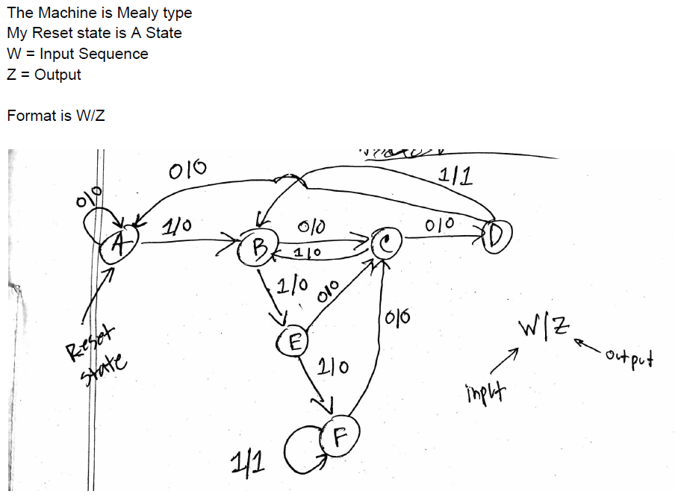
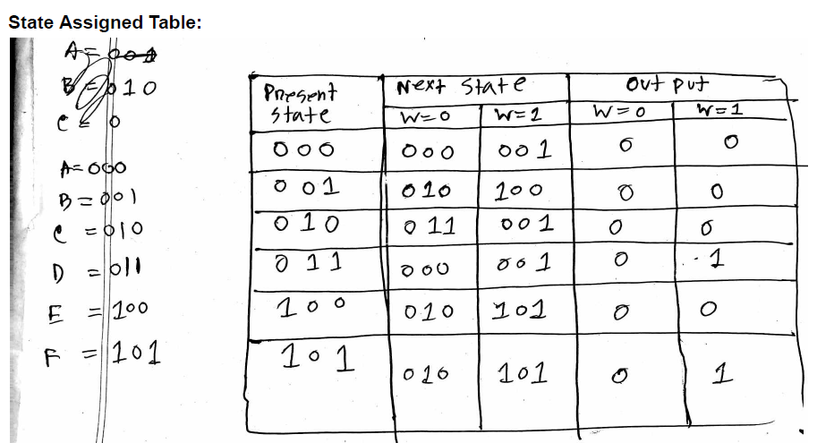
Solution:

Slide 14
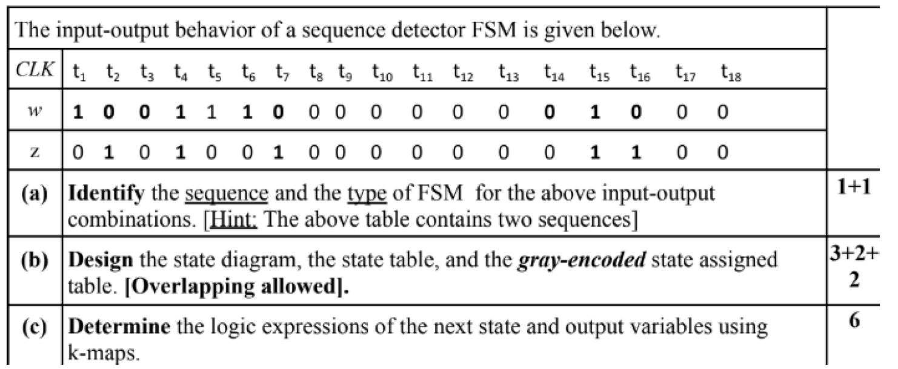
Example 4:
** Alternating 0 and 1
** Two consecutive inputs are different

Slide 15
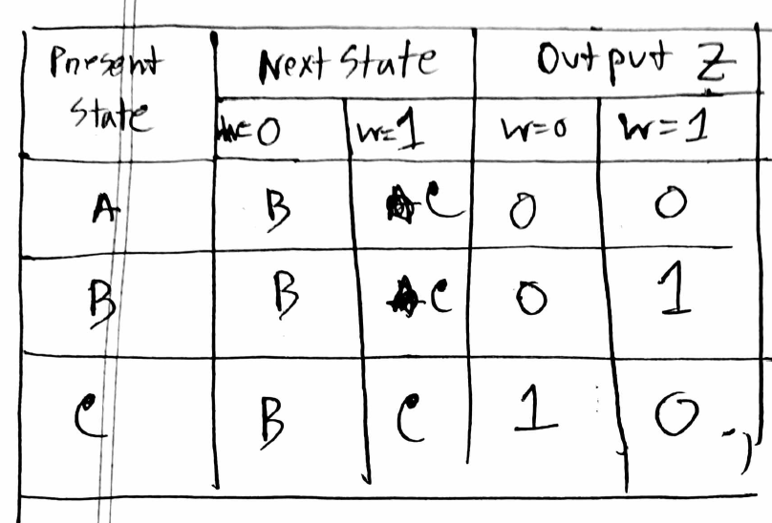
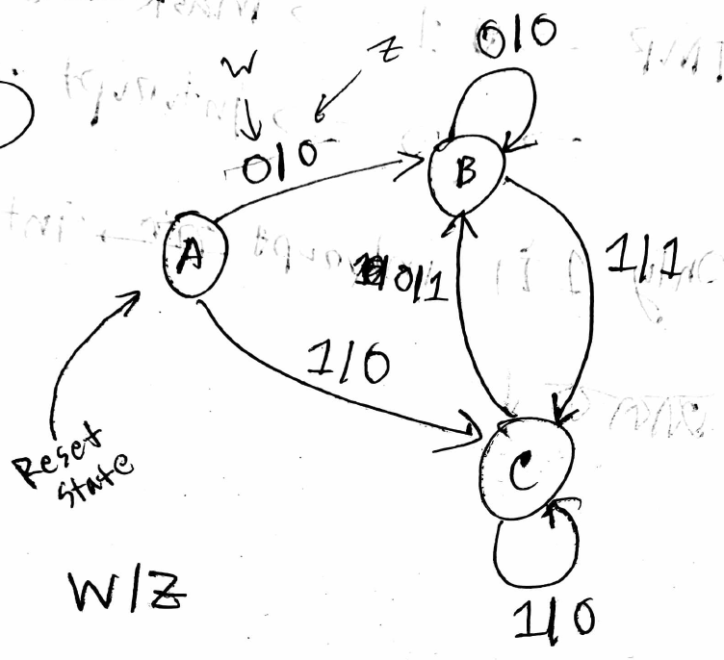
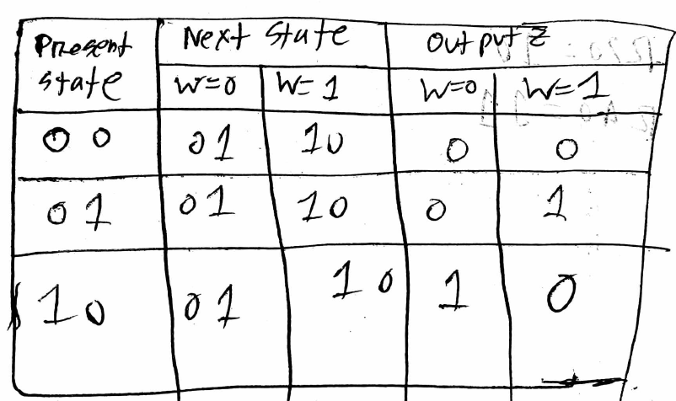
Solution:
11
11
11
11

Slide 16
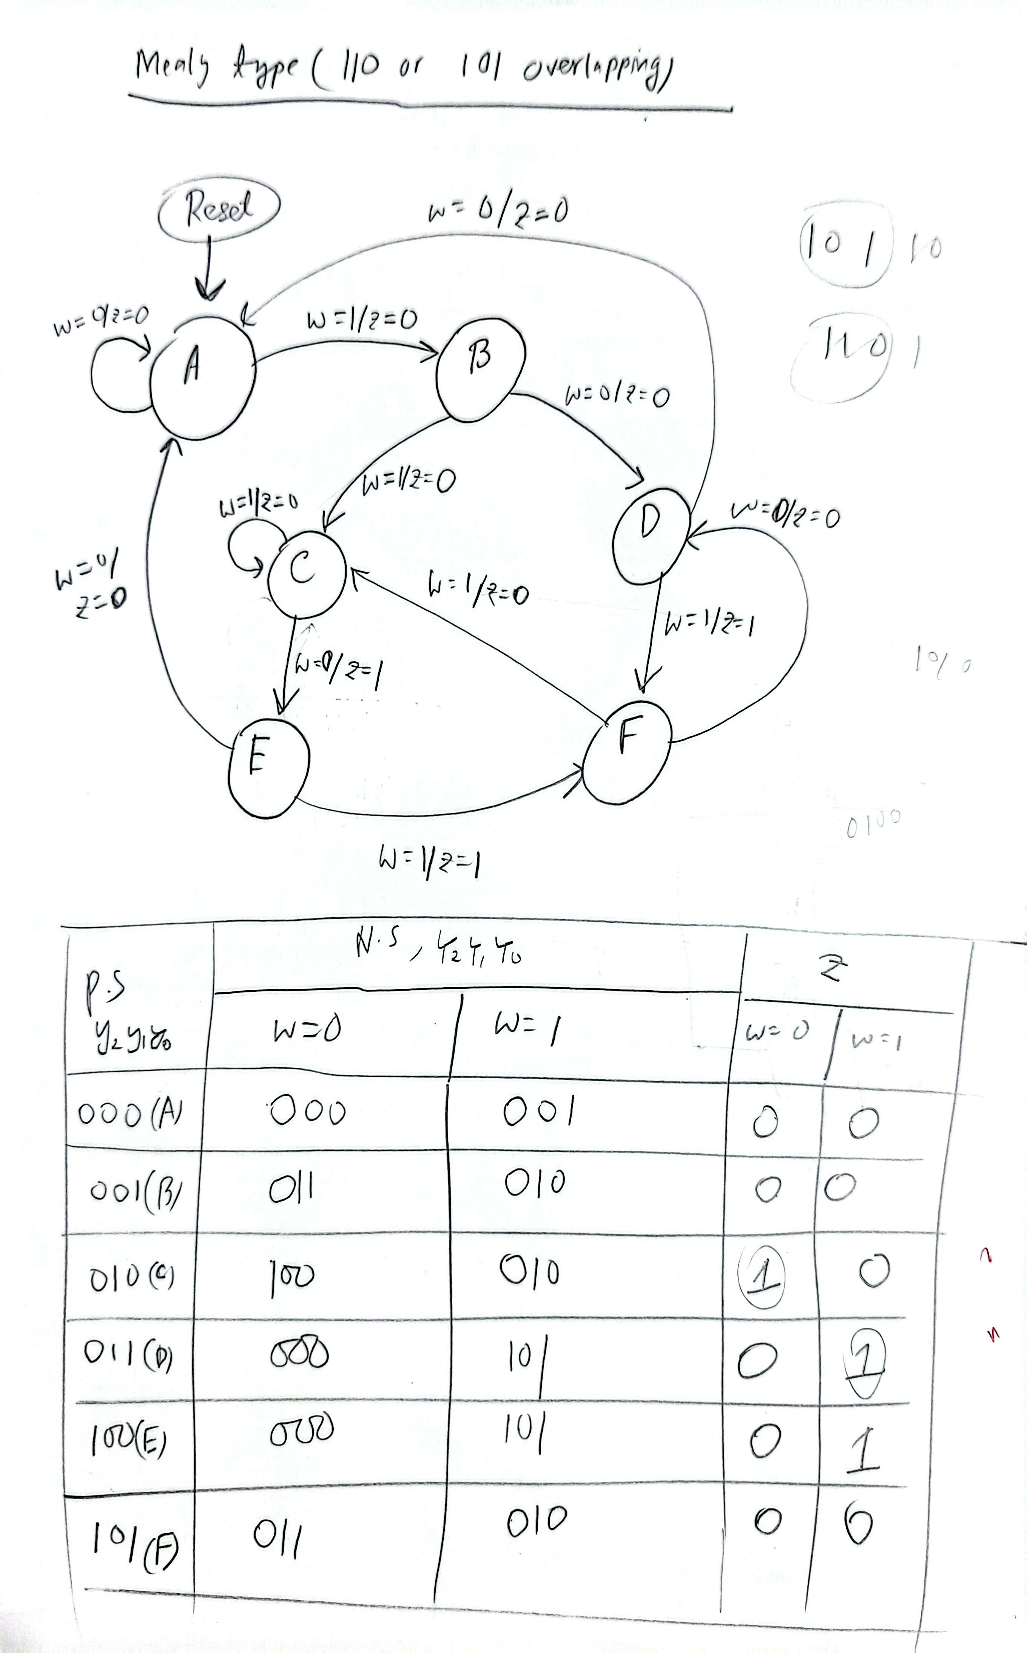
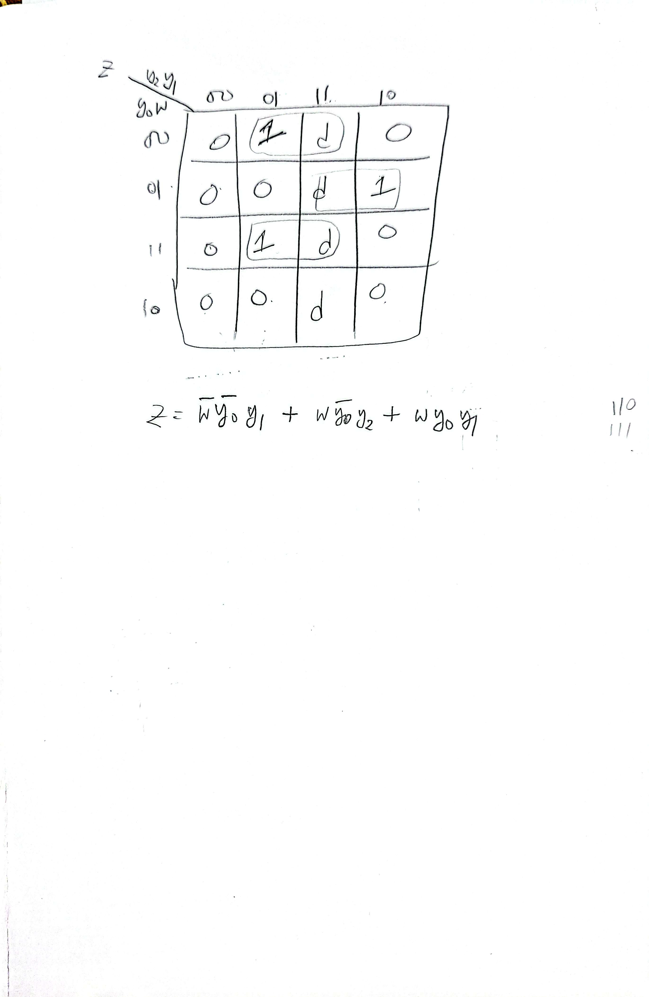
Draw the state diagram for detecting 110 or 101 overlapping sequence in a data stream. Output,z should be high in the same clock cycle. (b) Also derive the state assignment table for this. (c) Finally derive the output expression for this design.

Slide 17
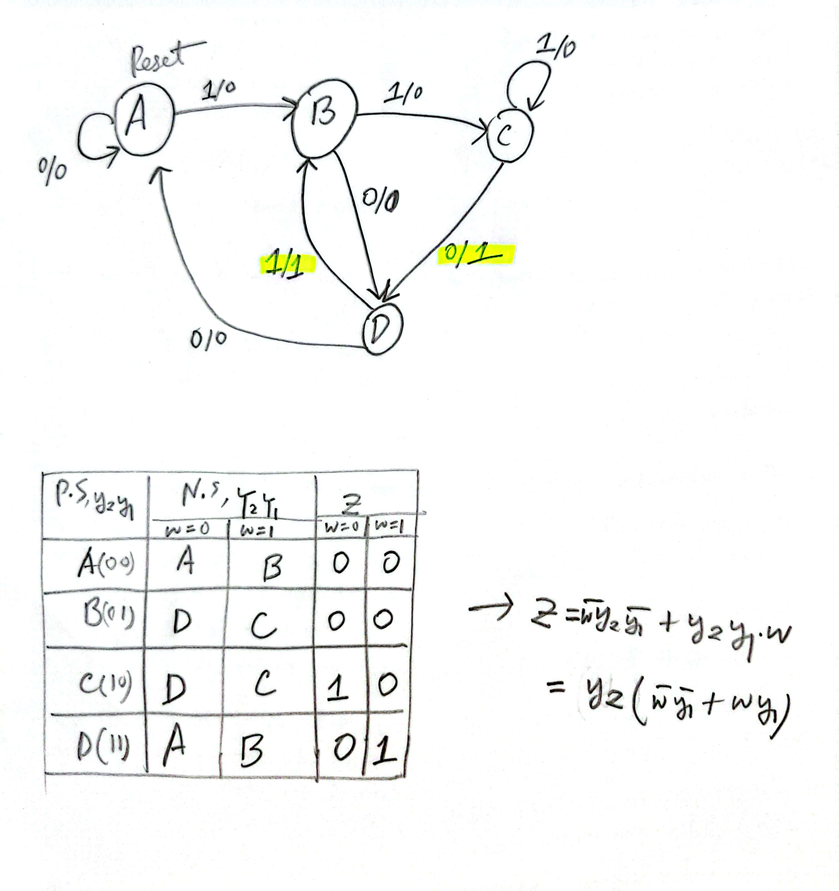
(a)Draw the state diagram for detecting 110 or 101 overlapping sequence in a data stream. Output,z should be high in the next clock cycle. (b) Also derive the state assignment table for this. (c) Finally derive the output expression for this design.

Slide 18
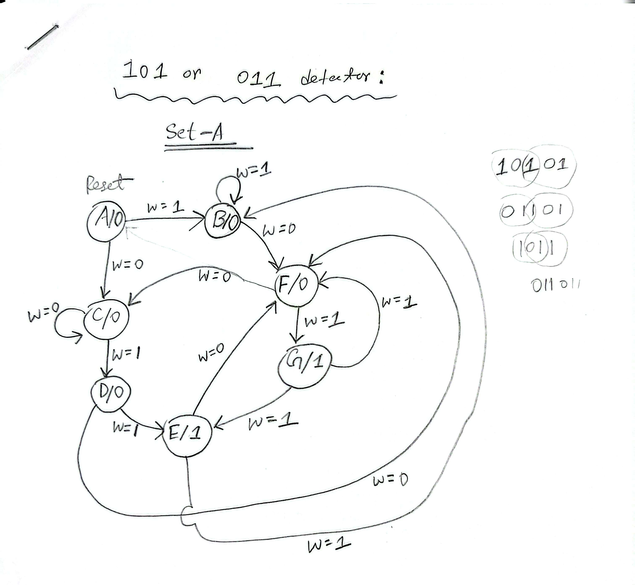
101 or 011 Overlapping Moore FSM

Slide 19
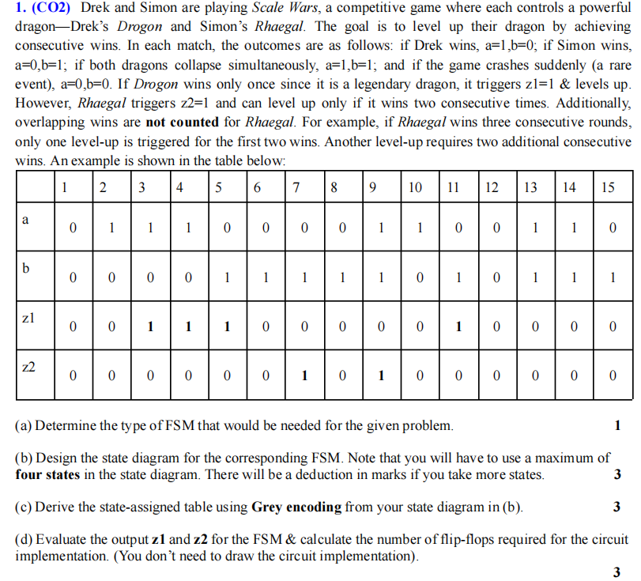


Slide 20
